Slide 1
BukaToko
Business Case I
13 November 2019

Slide 2
Case Background
BukaToko

Slide 3
Case Background
Business Case I
BukaToko is one of the Leading Startup in Marketplace Industry. With Vision to help small business to get wider market and buyers can buy safely, BukaToko creates trusted payment ecosystem for both seller and buyer.
Even tough BukaToko have a complex security to protect transaction of sellers and buyers, several frauds have inflicted loss to all parties, especially BukaToko itself.

Slide 4
Problem Identification & Problem Statement
BukaToko

Slide 5
Problem Identification
Business Case I
Cashback Fraud
Fake “Cheap” Product
Transaction Outside Platform
Fake Shipping Receipt

Slide 6
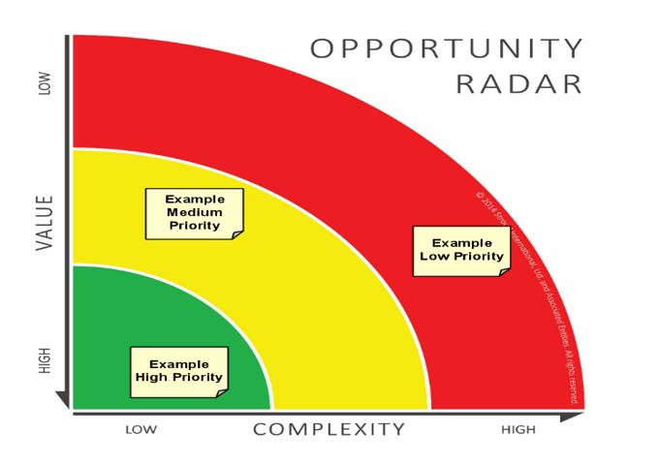
Problem Prioritization
Business Case I
To prioritize problem, we have to considers Value and Complexity.
Those in the “green” of highest value and lowest complexity should be resourced first. Those out in the “red” should not be resourced. As problems in the green are solved, others will move in to their place, to be resourced next.
Source: https://www.budtoboss.com/difficult-situations/prioritization-means-choosing-problems-not-solve/

Slide 7
Prioritization Matrix
Business Case I
Low Complexity and High Value
Fake “Cheap” Product
High Complexity and High Value
Cashback Fraud
Transaction outside Platform
Low Complexity and Low Value
Fake Shipping Receipt
High Complexity and Low Value
Based on Prioritization Matrix, there is one problem in Low Complexity and High Value Box. The problem that will be prioritized is Fake “Cheap” Product.
The problem has high value as Customers and BukaToko will be impacted financially by transaction of Fake Products. This case also will be impacting BukaToko brand image as secure Marketplace. As Marketplace with vision to providing safe shopping environment for Buyer to Buy, BukaToko needs to ensure credibility of item promoted on its Platform.
Considering this, Fake “Cheap” Product is selected on this Business Case.

Slide 8
Problem Solving
Business Case I

Slide 9
Business Component
Business Case I
Fake “Cheap” Product
Antifraud
Marketing
Customer Service
Legal
Seller Verification Team
Product Management
Finance & Accounting
Data Analytics
The team for thi cases consisted from Cross-Functional Unit:
Product Management responsible for the overall selling platform.
Antifraud responsible to fraud detection and mitigation
Data Analytics consisted of Data Analyst and Scientist, managing all transaction data and records
Marketing mitigating impact of Company Branding
Finance & Accounting mitigating and resolved finance and cost risk
Seller Verification Team responsible on KYC on seller
Customer Service handlung customer complaints and inquiry
Legal handling legal aspect on this case

Slide 10
Problem Statement
Business Case I
“Fake “Cheap” Product is a Fraud by the Seller done by listing Fake Product with relatively cheap price to attract customer’s transaction to buy the products. As a Leading Marketplace, BukaToko have vision to facilitate safe transaction between Seller and Buyer, by providing secure Transaction Platform. Hence, BukaToko responsible to solve current fake “cheap” product case and mitigate future risk.”

Slide 11
Case Identification
Business Case I
Fake “Cheap” Product
Seller listing Fake Product with Cheap Price
The listing have high click rate due to its price
High transaction on the fake product may exceed popularity of original product
Buyer attracted and buy Fake Product because its cheap price
Buyer receive Fake Product
Buyer escalate complaint because of Fake Product
Buyer give bad review on the product listing
Buyer ask for refund
Buyer give bad review of BukaToko that listing Fake Product on its Platform
Seller receive the money from selling fake product
Fake products have the high risk on customer’s health and safety
BukaToko receiving legal sue from Original brand holder as providing platform for transaction of FakeProducts.

Slide 12
Understanding – Business Essential
Business Case I
Financial Aspect
Seller receive money from Fake Product Transaction
Branding & Legal Aspect
This case will give bad image on BukaToko as credible marketplace
Customers ask for refund
Customer’s Experience
Fake product’s popularity may exceed the Original and Credible Product listed by Credible authentic seller
The Fake Product have high risk on customer’s safety and health, also may be hazardous for customers.
Product Listed in BukaToko having high numbers of bad reviews

Slide 13
Solution Synthesis
Business Case I
Customers’s Experience
Providing fast solution for Customer’s Inquiry on Fake Product
Seller
Enhance seller verification system, identify and mitigate potential fraud seller using ML Model.
Financial & Legal
Transaction verification before seller payment.
Proviidng platform for Original Manufacturer to promote their brand on BukaToko.
Develop fraud detection system and verification system of listed product in BukaToko using ML Model.
Prioritizing Credible product from verified user on product listing recommendation
Identifying and take down fake product based on customer’s inquiry and review

